Slide 1
Heart Failure QI Projects
Kickoff Meeting
January 26, 2021
12:00 -1:00 PM EST
ACTION HF Committee

Slide 2
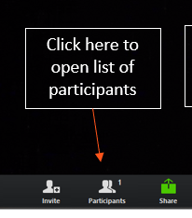
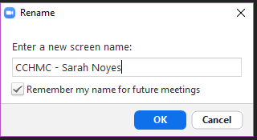
Tips for Optimizing Zoom Experience
Rename yourself by clicking on the blue “rename” button that appears next to your name in the “participant” panel
RENAME TO:
Abbreviated Team Name – first name, last name
(Example: CCHMC – Sarah Noyes)
Notes:
Lauren

Slide 3
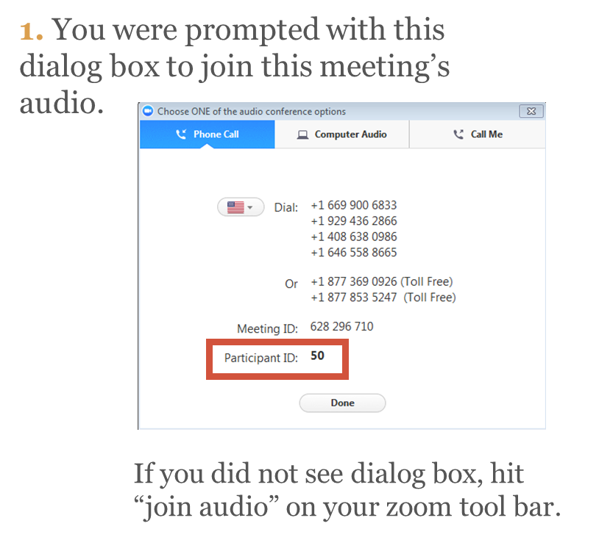
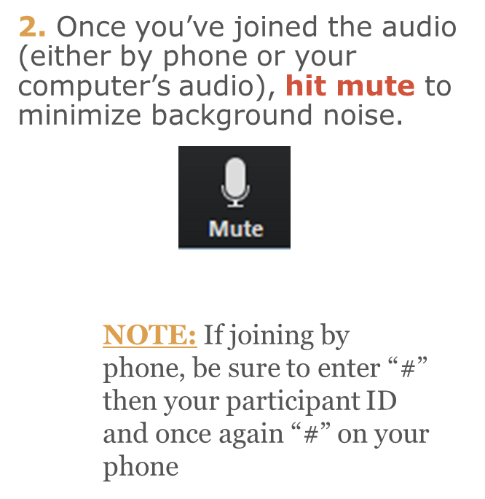
Zoom Reminders & Audio Information
Join via Zoom application (NOT A WEB BROWSER)
Notes:
Lauren

Slide 4
22 Sites Participating in the HF QI Projects
Boston Children’s Hospital | Monroe Carell Jr. Children's Hospital
C.S. Mott Children’s Hospital | Morgan Stanley Children’s Hospital of New York Presbyterian
Children’s Health Dallas/UT Southwestern | Nationwide Children’s Hospital
Children's Healthcare of Atlanta | Norton Children's Hospital
Children’s Hospital at Montefiore | Oschner Hospital for Children
Children's Hospital of Colorado | Primary Children's Hospital
Children’s Hospital of Philadelphia | Stollery Children's Hospital
Children’s Hospital of Pittsburgh | Texas Children's Hospital
Cincinnati Children’s Hospital Medical Center | The Hospital for Sick Children
Le Bonheur Children's Hospital | UCSF Benioff Children's Hospital
Lucile Packard Children’s Hospital | University of Minnesota Masonic Children's Hospital

Slide 5
Agenda
Topic | Topic Leader(s) | Duration
Welcome & Agenda Review | Lauren | 5 min
Project Background | Kathleen/ Joey | 10 min
Intervention Rollout | Chloe S./ Kenton | 15 min
Measure and Data Collection | Chloe C./ Lauren | 10 min
Project Structure and Process | Lauren | 5 min
Rollout Tips & Questions | HF Leadership Team | 10 min
Wrap Up & Next Steps | Lauren | 5 min

Slide 6
Project Background Communication Checklist & Discharge Plan
Kathleen Simpson
Joey Spinner
10 minutes
12:05-12:15 PM

Slide 7
Background – Why Are These Projects Important?
Testing hypothesis that patients will experience better clinical outcomes with a more standardized and comprehensive approach to patient/family communications and transition planning
ACTION site survey data suggests creating standardized processes and tools for daily huddles and discharge protocol is an area of opportunity
Exhibit 1.
Do you have an established discharge checklist for patients with heart failure?

Slide 8
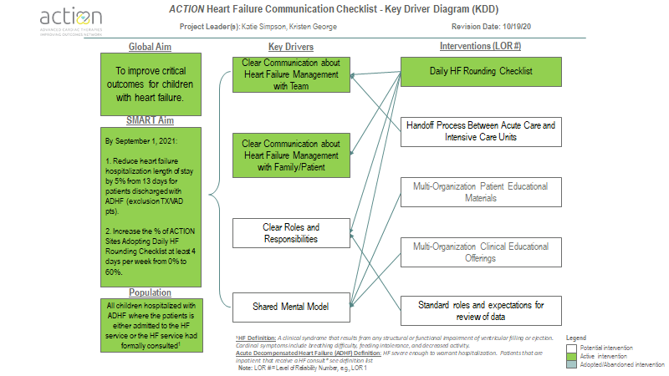

Slide 9
Project Overview – Communication Checklist
What is it?
The tool is to be used daily by the clinical team to ensure consistent and comprehensive communication to patients and families.
Who is it for?
The Communication Checklist is intended for regular use by the clinical staff.
What is the purpose of the Communication Checklist?
To standardized language usage and team communication for inpatient heart failure patients via a daily bedside communication checklist tool in effort to improve outcomes in patients during ADHF admission.
Serve as a data collection tool to inform future QI initiatives

Slide 10
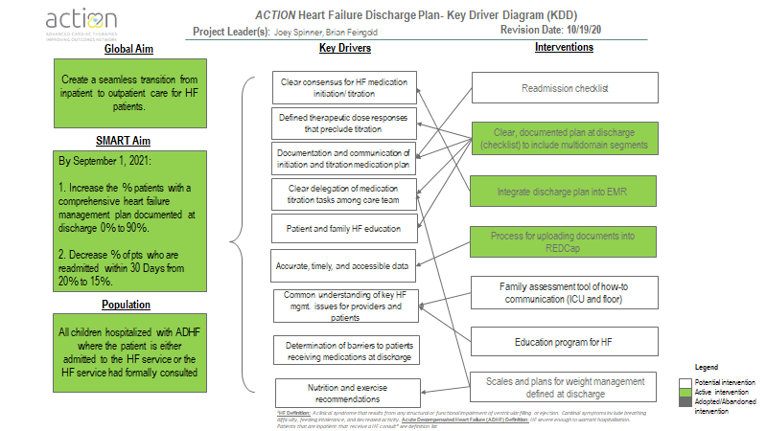

Slide 11
Discharge prescription is strongly correlated with post-discharge adherence
Significantly fewer eligible patients without a discharge prescription were initiated on therapy as outpatients

Slide 12
Discharge prescription is strongly correlated with post-discharge adherence
Significantly fewer eligible patients without a discharge prescription were initiated on therapy as outpatients
System based barriers and clinical inertia among healthcare providers were prominent factors

Slide 13
2011–2019 discharge data (PHIS)
ACEi/ARB was prescribed in 64.6% (n= 1479 patients)
Beta blocker was prescribed in 49.5% (n= 1132 patients)
MRA was prescribed in 37.8% (n= 864 patients)

Slide 14
Project Overview – Discharge Plan
What is it?
Document/tool is used by the clinical team to ensure consistent and comprehensive discharge planning for patients.
Who is it for?
The Discharge Plan is intended for regular use by the clinical staff.
What is the purpose of the Discharge Plan?
Standardize the discharge planning process to reduce “clinical inertia”, address system barriers, improve communication and more effectively transition patients to outpatient care, and reduce readmissions
Serve as a data collection tool to inform future QI initiatives

Slide 15
Intervention Rollout
Chloe Stegeman
Kenton Reason
15 minutes
12:15 – 12:30 PM

Slide 16
Improvement Project Structure
March, 2020
January, 2021
Design and Plan
Opt – in Learning Cohort
Network Wide Improvement
Sustain improvement
Team: 6-10 Experts
Deliverables:
AIMs,
Family of Measures,
Data Collection Approach
Improvement Theory
KDD
Determine center commitment for participating
Team: 22 sites
Deliverables:
Evidence of improvement
Improvements in process measures
Collect outcome and process data via REDCap
Team: Spread - All Centers
Deliverables:
All centers adopt measures & improvement approaches at their local environment
Network wide/aggregate improvement
Team: All Centers
Deliverables:
Review measures quarterly
Convene experts if special cause
Improvement work starts here!
References: IHI, SPS, NPC, CNU, Anderson Center (LHS) , Actor Orient Network
Notes:
Design and plan phase is done (more details on interventions and measures coming later in meeting). Now moving on to opt-in learning cohort.

Slide 17
Intervention Rollout
User Journey
While this initiative combines two separate Quality Improvement projects, they are connected to the same overarching goal of improving critical health failure patient outcomes.
The connection between these two tools are transcribed through three steps:
Patient Eligibility Criteria
Communication Checklist Usage
Discharge Plan Usage
This user journey highlights key components of each of these steps.

Slide 18
Intervention Rollout
Overview
Patient
Eligibility
The following criteria will be used to determine which patients are eligible for both HF QI initiatives.
Inclusion:
Meets ACTION definition for ADHF (HF leading to hospitalization)*
Cardiac diagnoses: DCM, RCM, HCM, ARVC, Failing Fontan/Glenn irrespective of myocardial function, myocarditis, chemotherapy-induced toxicity with EF <45%, Muscular dystrophy with EF <45%
All ages provided admitted to an ACTION hospital
If patient receives a VAD during admission they will be eligible for the communication checklist and the discharge plan project.
Exclusions:
Patients with history of heart failure admitted for other reason (non-heart failure episode)
If a patient is transplanted during their admission they will be eligible for the communication checklist but not the discharge plan.
01
Notes:
* HF Definition: A clinical syndrome that results from any structural or functional impairment of ventricular filling or ejection. Cardinal symptoms include breathing difficulty, feeding intolerance, and decreased activity.
Acute Decompensated Heart Failure (ADHF) Definition: HF severe enough to warrant hospitalization.

Slide 19
Intervention Rollout
Overview
Purpose: To standardize language usage and team communication for inpatient heart failure patients via a daily bedside checklist tool in an effort to improve outcomes in patients during acute heart failure admission.
Responsibility: The checklist should be completed daily on rounds between the multi-disciplinary team (below).
Stakeholders: All participants should be included in this daily process:
Attending, support staff (PA, APP, etc.), trainees (MS, residents, fellows, bedside RN or RN representative, family member (if bedside), and patient (if age appropriate)
How to Complete the Communication Checklist:
01
02
Communication
Checklist
Huddle team around the tool
Scan the QR Code
Complete the attestation survey
Repeat
daily

Slide 20
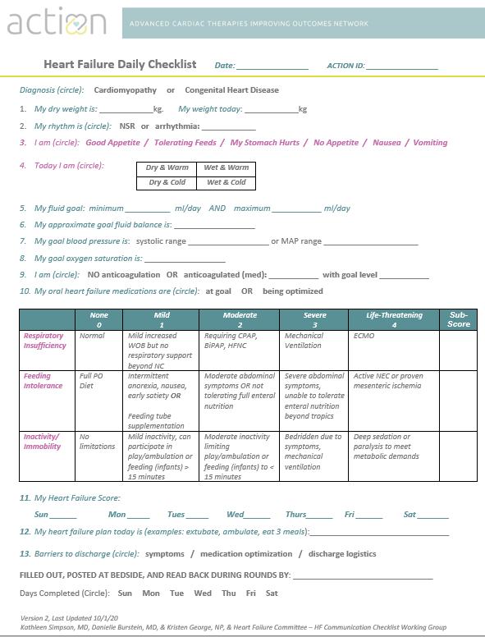
Intervention Rollout
Communication
Checklist
(QR code for frequency of use tracking)
01
02

Slide 21
Intervention Rollout
Overview
Purpose: The primary aim of the Discharge Plan is to standardize the internal discharge planning process for patients in an effort to reduce readmission and effectively transition to outpatient care, while also providing insight for future quality improvement efforts pertaining to children with acute heart failure.
Responsibility: The Discharge Plan is to be completed one time, prior to discharge, by a multi-disciplinary team and reviewed with the patient and family.
Stakeholders: Stakeholders should be included before completion and team should identify which member (typically nurse coordinator or bedside nurse) will have primary responsibility for completing the discharge plan.
How to Complete the Discharge Plan:
01
02
03
Discharge
Plan
Assemble multi-
disciplinary team
Review plan and identify submitter for fillable form, create PDF
Review plan with family
Share plan with other providers
(upload to REDCap if not completed by fillable form)

Slide 22
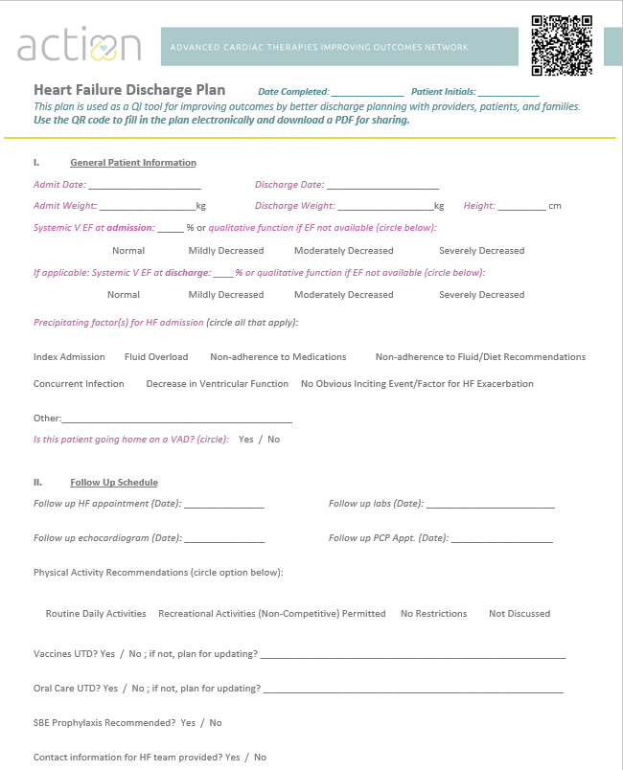
Intervention Rollout
Discharge
Plan
(QR code for fillable form)
01
02
03

Slide 23
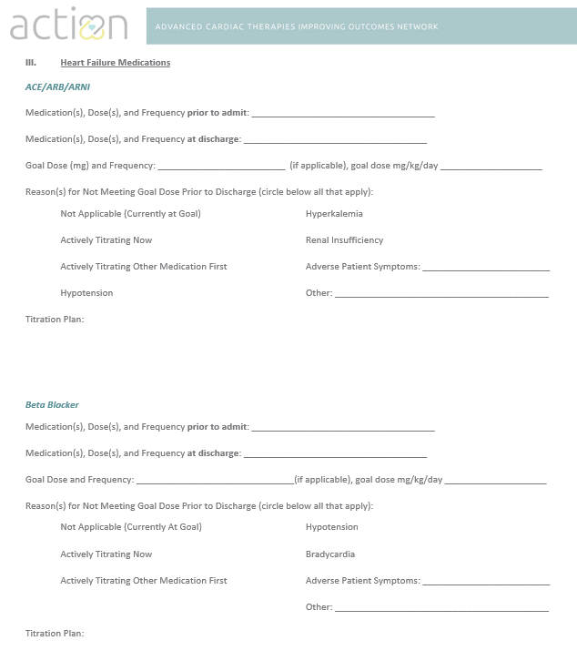
Intervention Rollout
01
02
03
Discharge
Plan

Slide 24
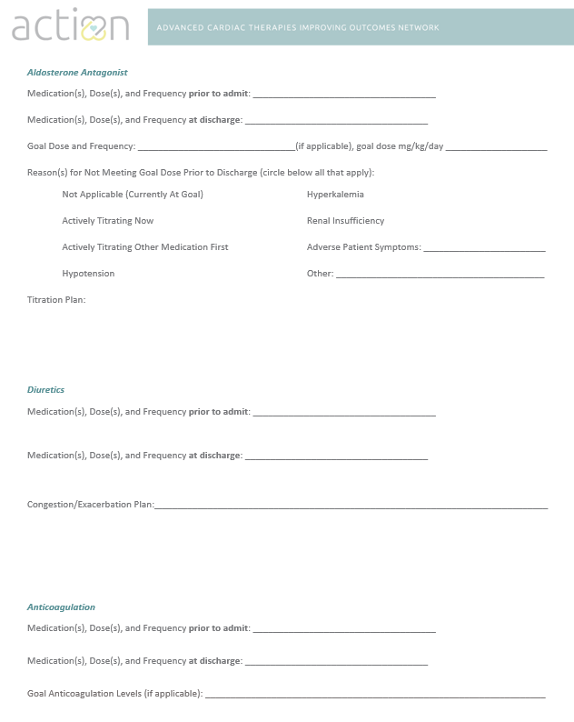
Intervention Rollout
01
02
03
Discharge
Plan

Slide 25
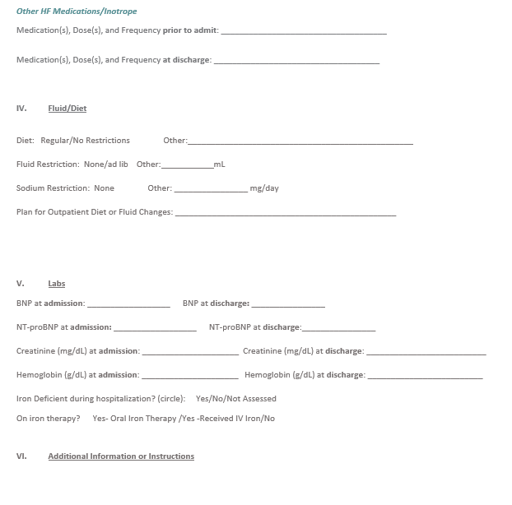
Intervention Rollout
01
02
03
Discharge
Plan
The Discharge Plan is also available in a fillable template. All modalities of the form will need to be saved as a PDF for sharing and uploaded to REDCap

Slide 26
Intervention Rollout
Summary
Patient
Eligibility
As highlighted, these two initiatives will accomplish the following:
Improve communication about patient status and treatment goals among care team members (including patients) may help improve patient outcomes.
Aid in a seamless transition from inpatient to outpatient care for children with acute heart failure.
The integration of the Communication Checklist and Discharge Plan will help sites to achieve the overarching goal of improving critical heart failure outcomes for pediatric patients.
01
02
03
Communication
Checklist
Discharge
Plan

Slide 27
Measures and Data Collection
Chloe Connelly
10 minutes
12:30-12:40 PM

Slide 28
Communication Checklist – Family of Measures
The Patient Inclusion Criteria should be used to help identify which patients are eligible/ ineligible to be included in data collection.
The Measures Specific to the Communication Checklist are below:
Outcomes
Average length of HF hospitalization stay
Hospital mortality rate
Process Measures
Percent of ACTION sites adopting Daily HF Communications Checklist at least 4 days per week
Notes:
Need to highlight meeting as a group weekly/monthly to guide data discussion to be able to complete the monthly survey
Potential options: post measures centralized place to collect data, lead data collector reaches out for input for colleagues

Slide 29
Communication Checklist – Data Elements
To supply the needs of analyzing the specific measurements, there are key data elements that need to be captured
The recommended data capture method for the the Communication Checklist survey is below:
Recommendation
QR Code
Repeat
The recommended method of tracking the frequency of daily checklist use is to scan the QR code each day you use the checklist
When you use the checklist, simply scan the QR code, enter the data for the 3 fields, and submit
Do this each day you use the checklist
Notes:
Need to highlight meeting as a group weekly/monthly to guide data discussion to be able to complete the monthly survey
Potential options: post measures centralized place to collect data, lead data collector reaches out for input for colleagues

Slide 30
Discharge Plan – Family of Measures
The Patient Inclusion Criteria should be used to help identify which patients are eligible/ ineligible to be included in data collection
The Measures Specific to the Discharge Plan are below:
Outcomes
Percent of patients who are readmitted within 30 Days of discharge
Process Measures
Percent of patients with a comprehensive heart failure management plan at discharge
Notes:
Need to highlight meeting as a group weekly/monthly to guide data discussion to be able to complete the monthly survey
Potential options: post measures centralized place to collect data, lead data collector reaches out for input for colleagues

Slide 31
Discharge Plan – Data Elements
To supply the needs of analyzing the specific measurements, there are key data elements that need to be captured.
The specific data elements captured in the Discharge Plan Data Elements are below:
General Patient Information
Follow Up Schedule
Heart Failure Medications
Fluid/Diet Information
Labs
Additional Instructions

Slide 32
Patient REDCap Data Entry – Patient Consent
Reminder: Please remember to consent all patients involved in HF QI projects. All sites will complete the REDCap form for each participating patient, no matter the project. If you have questions or concerns, please reach out to your VAD contact at your site for instructions/ details on getting ACTION consent.

Slide 33
Data Access Groups for REDCap
For the patient-level heart failure REDCap, data access groups are being used. You must have a CCHMC REDCap account to enter data or view data for this project.
Question – If I already have a REDCap login I use at my center, do I still need to complete this survey and get a new username?
Answer – YES. This ACTION REDCap project is specific to CCHMC, which is where this project data is being collected, so you will still need to complete the survey above and send us your username.
Question – How is this different from other REDCap ACTION projects?
Answer – All of our other ACTION projects that use REDCap collect data via the survey function of REDCap. By setting up logins and data access groups for this Heart Failure project, users will be able to log into the REDCap database and enter data, save the data, return at a later time, and produce site-specific data exports. Users will be able to interact with the data like a typical database or registry.
Notes:
Need to highlight meeting as a group weekly/monthly to guide data discussion to be able to complete the monthly survey
Potential options: post measures centralized place to collect data, lead data collector reaches out for input for colleagues

Slide 34
ACTION ID – Standardization
ACTION ID process standardized for this project (and will be rolled out to other QI projects soon!) This will allow better tracking of patients between ACTION projects and will be more clear for data analytics on back end.
ACTION ID will be populated each time you enter data
Step 1
Step 2
Step 3
ACTION ID
Select your hospital name
Patient’s full name initials (First, Middle, Last)
*Use “x” if patient does not have middle initial
Patient’s full DOB
This creates an ACTION ID with a mathematical equation that de-identifies the ID
For example, if CCHMC site number was 10, using Lauren Elise Smyth, and DOB: 05/02/1988
010-LES-5022010 is the generated ACTION ID

Slide 35
Patient REDCap Data Entry
Patient REDCap Data Entry
Patient REDCap Survey
Each site will be required to submit individual level data for patients in a REDCap survey, regardless of which intervention they are participating in.
Intervention Selection
Sites have the choice to decide which interventions they are partaking in, as well as the option of how they implement data collection into their processes.
Communication
Checklist
Discharge
Plan
Data Entry
Once data is collected for either intervention, sites will have to submit data specific to each intervention based on the intervention requirements.
Communication
Checklist
Data Entry
Discharge
Plan
Data Entry

Slide 36
https://redcap.research.cchmc.org/index.php?action=myprojects

Slide 37
Project Structure and Process
Lauren Smyth
5 minutes
12:40 -12:45 PM

Slide 38
Principles of HF QI Projects
Data Driven
Evidence-based when applicable
Inclusion of patients based on inclusion and exclusion criteria (can reference in Project Charter)
Collaborative Learning
Orchestrated testing from high performing centers
Learning from testing and best practices
Respect Local Resource, Time, and Personnel Limitations
Interventions developed by community
Not dependent on current technology in your institutions
Interventions allow flexibility and modifications to fit local practice
Limited additional data collection
Notes:
The hope is that the testing of these interventions will complement the work you are already doing, and not be too much of a burden.

Slide 39
QI Best Practices
“Perfection is the enemy of pretty darn good!”
Iterative change vs. implementation
Create project roles
Build data collection into standard duties
Ask for help!

Slide 40
How Can We Practice This?
Interventions will be tested by each participating site
Participate in monthly meetings to share learnings
Submit HF patient data via REDCap when patients are discharged, scan QR code for checklist frequency, upload Discharge Plan into REDCap, and complete PDSA surveys
Notes:
During monthly huddles we will.....
Review data
Teach QI tools
Learn what’s working and what isn’t
Plan next test
In between huddles....
Complete the “Do” in the PDSA
Collect and submit data

Slide 41
Rollout Tips & Questions
HF Leadership Team
10 minutes
12:45 -12:55 PM

Slide 42
Rollout Tips****
Easiest to implement at end of presentation
Laminated it and posted at bedside for families to see and for communication with nighttime bedside RN
Used dry erase marker and just erased what had changed from day to day with reviewing entire sheet daily
1st day takes longest, subsequent days go very quickly
“Took 4-5 minutes first day and then 2-3 minutes subsequent days”
VERY Helpful to create “Shared Mental Model” improving communication with medical trainees, bedside staff and families
Preference to avoid more paper if possible (ie. Use of laminated version)
Positive feedback from team members and family

Slide 43
Wrap Up & Next Steps
Lauren Smyth
5 minutes
12:55 – 1:00 PM

Slide 44
Next Steps: Project Kickoff
Review Welcome Packet and Project Charter if you have not already done so (located on Basecamp)
Review interventions and FAQ documents (located in Basecamp)
Be prepared to discuss rollout feedback and initial testing data at next meeting
Standing meetings are the last Tuesday of the month from 12-1 PM EST
Plan to have at least 1-3 representatives (ideally involved in testing) from your site on the call

Slide 45
Next Steps: Data Collection & Surveys
Please enter retrospective data from your site into REDCap by EOD on 3/26
Complete the PDSA survey every other month (survey to be sent to the data collection representative on your team)

Slide 46
Appendix

