Slide 1
Update on Advanced Therapeutic Options for Fontan Patients
An ACTION Network Initiative
Insert your name
Delete and Insert your logo

Slide 2
Disclosures
Insert Disclosure One
Insert Disclosure Two
Insert Disclosure Three
Insert Disclosure Four, etc…

Slide 3

Audience Members
Scan the QR code to take the brief pre-presentation survey

Slide 4
“We have been focused on keeping the single ventricle patients alive during their childhood…
Now we need to focus on letting them live during their adulthood. ”

Slide 5
Fontan Facts

Slide 6
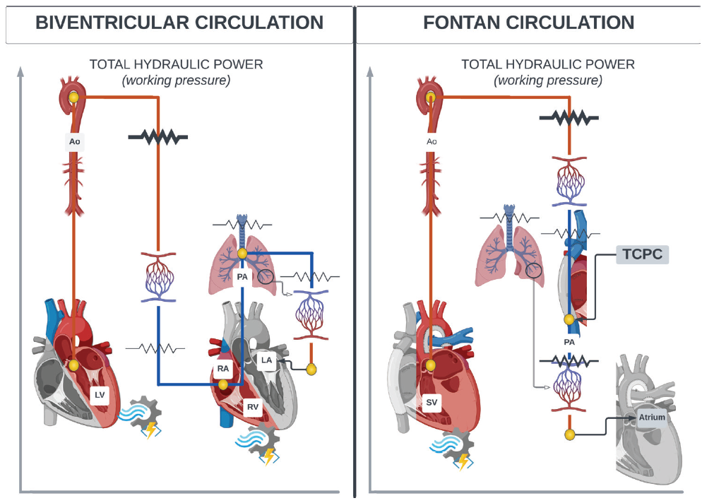
Fontan Physiology
Fontan
w
Lack of sub-pulmonary pump with passive flow to the lungs
Systemic ventricle must produce enough power to pump to systemic and pulmonary circulations
Chronically preload limited systemic circulation and obligatory systemic venous hypertension
Inefficient circulation, inability to normally augment cardiac output with increased demand
D’Angelo EC, et al. Heart 2022; 108: 1822–1831. doi:10.1136/heartjnl-2022-321006

Slide 7
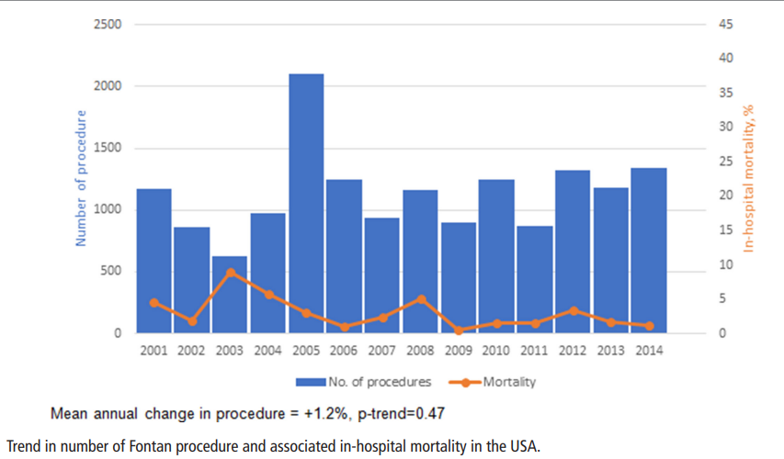
Improved Fontan Procedure Survival Over Time
Fontan
w
In-Hospital Mortality
< 2%
Akintoye E, et al. Heart 2019; 105: 708–714. doi:10.1136/heartjnl-2018-313680

Slide 8
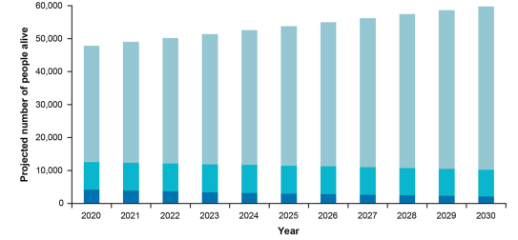
Increasing Population Projected Over Time
Fontan
w
>60,000
Fontan patients
will be receiving
care by 2030.
AP: Atrio-pulmonary
LT-TCPC: Lateral Tunnel
Total Cavopulmonary connection
EC-TCPC: Extracardiac Total
Total Cavopulmonary connection
Adv Ther (2022) 39:1004–1015

Slide 9
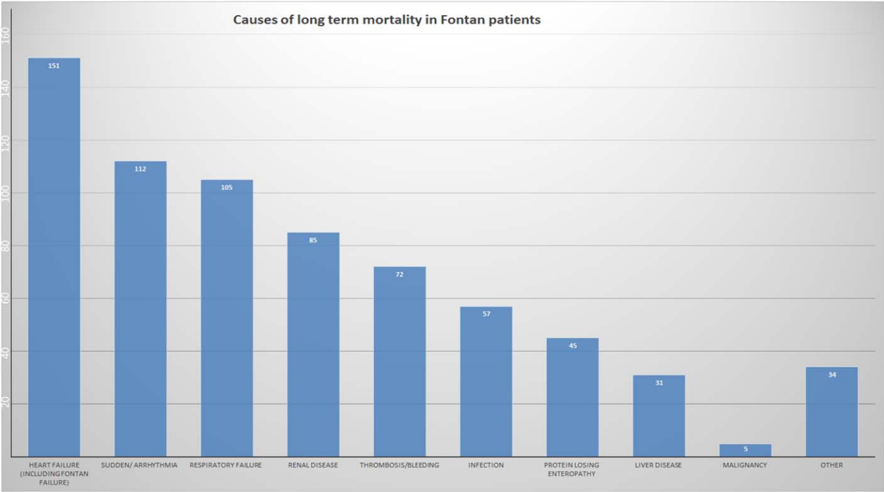
Heart Failure is the Greatest Cause of Mortality
Fontan
w
Systemic review of 6,707 Fontan patients
Heart/Fontan failure
most common cause of death and accounted for >20%
Alsaied T, et al. Heart 2017; 103: 104–110. doi:10.1136/heartjnl-2016-310108

Slide 10
Failed Fontan Physiology
Fontan
PB
Lymphatic Dysregulation
Ascites
Impaired thoracic duct drainage
Increased lymph production
Impaired renal function due to capsular restraint
PLE

Slide 11

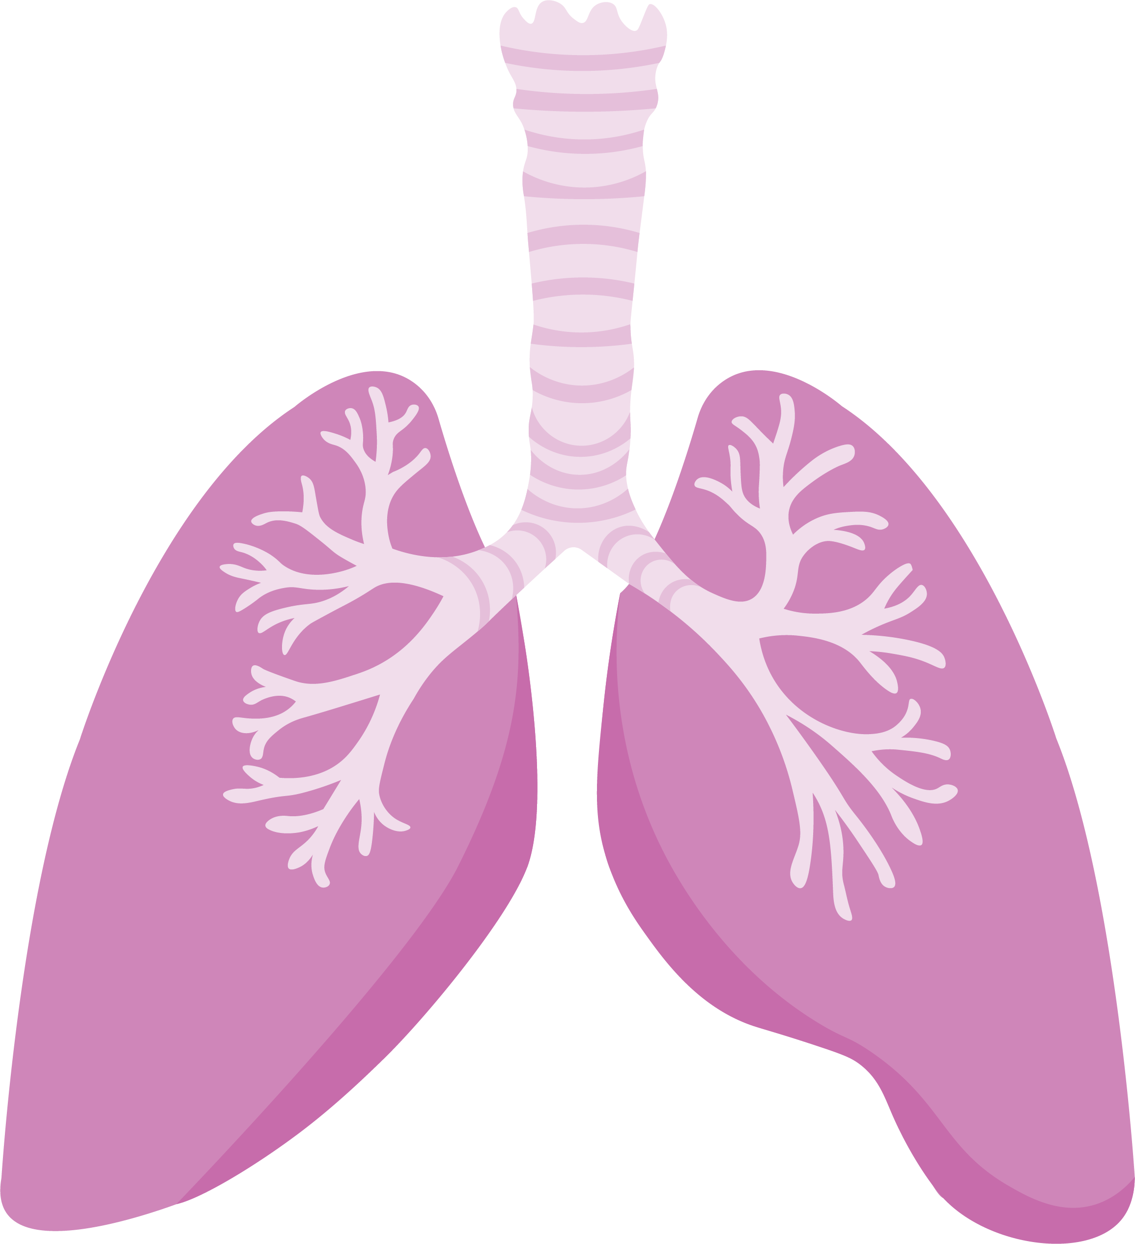

Multi-organ Consequences of Fontan Physiology
Fontan
Endocrinopathies:
Glycemic abnormalities
Thyroid disorders
Neurocognitive changes
Hematological abnormalities:
Thromboembolic complications
Secondary erythrocytosis
Pulmonary vascular disease
Sleep-disordered breathing
Restrictive lung disease
Plastic bronchitis
Fontan Circulation
Kidney abnormalities
Protein losing enteropathy
Pregnancy
Contraception
Sexual dysfunction
International Journal of Cardiology Congenital Heart Disease 8 (2022) 100358

Slide 12
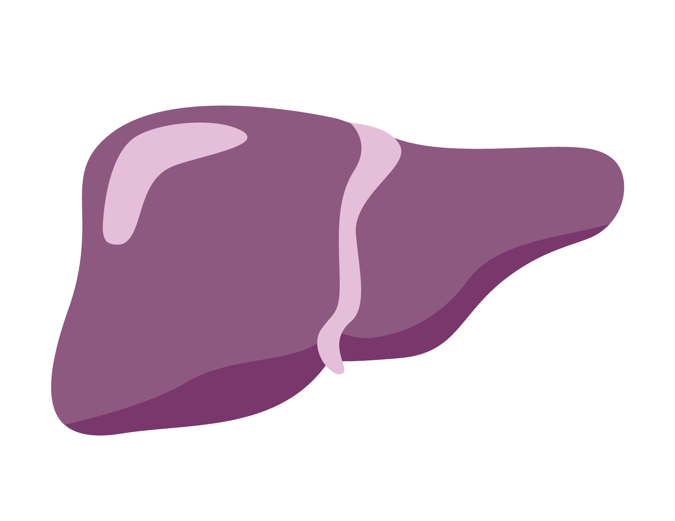
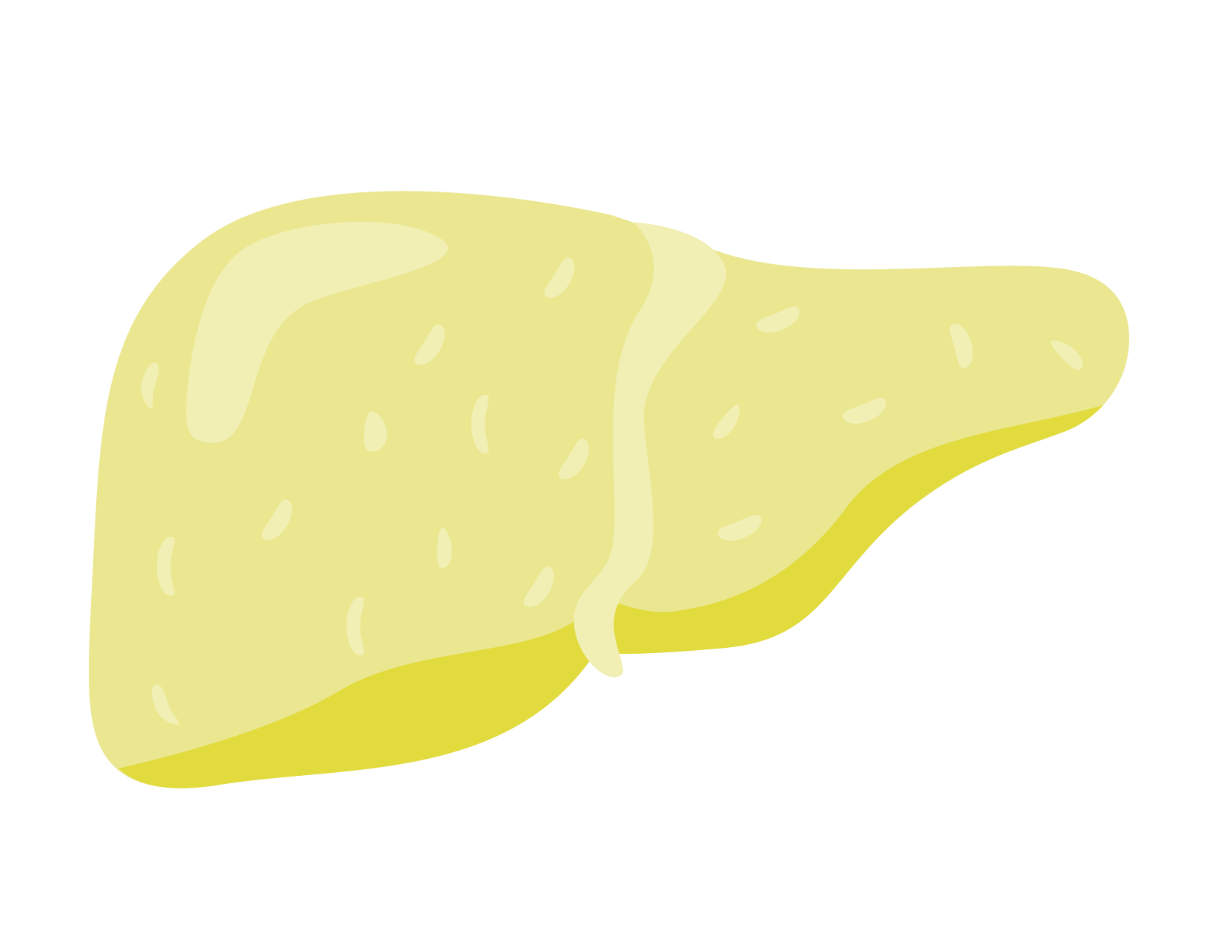
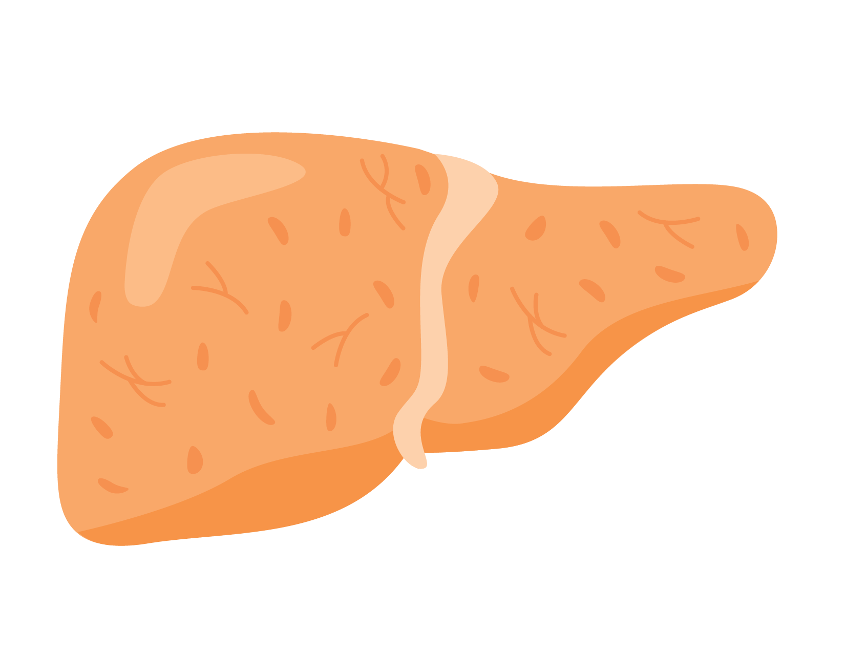
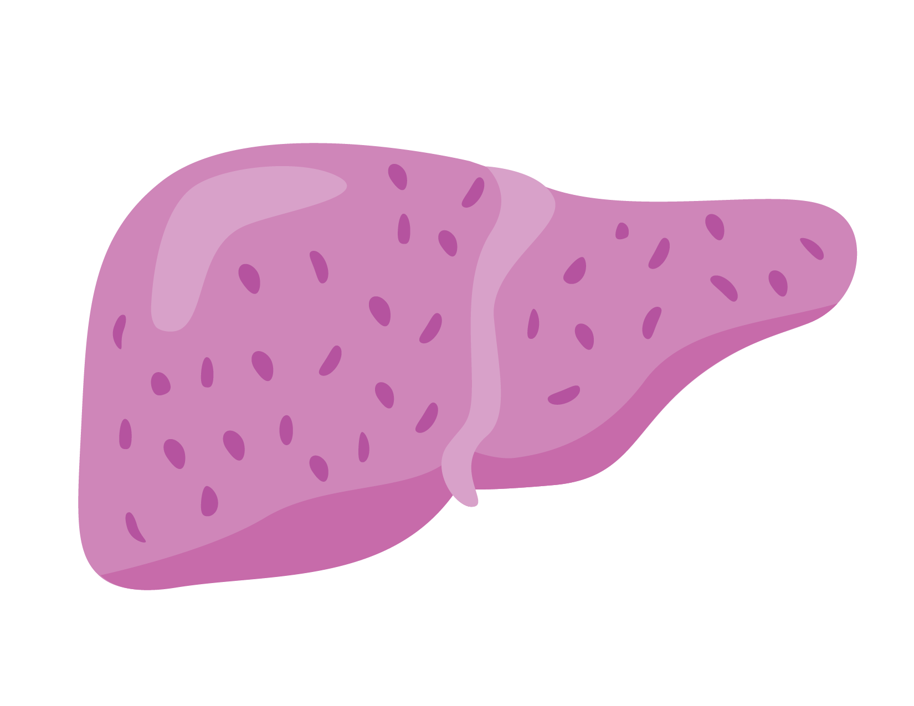
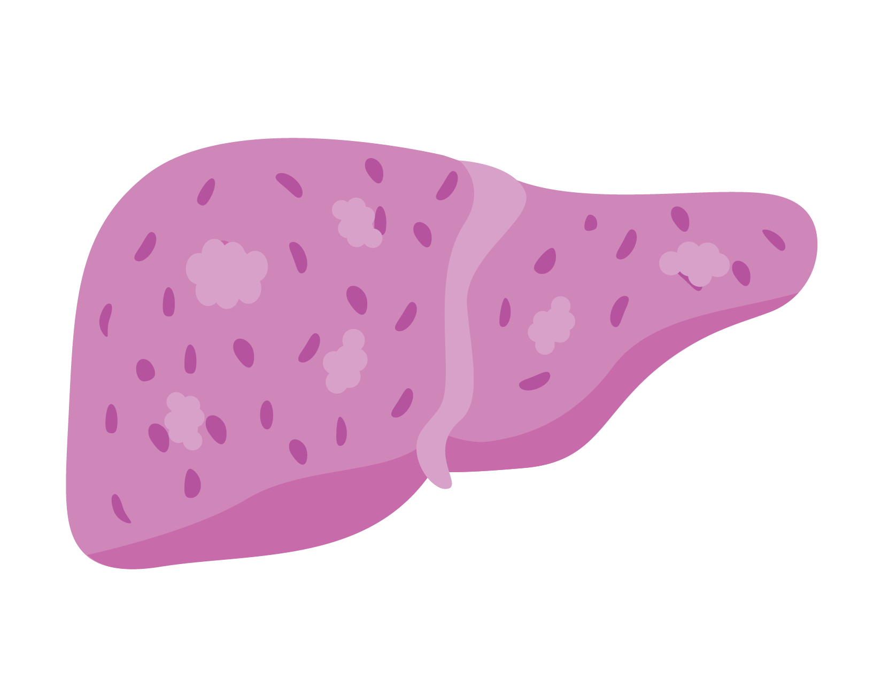
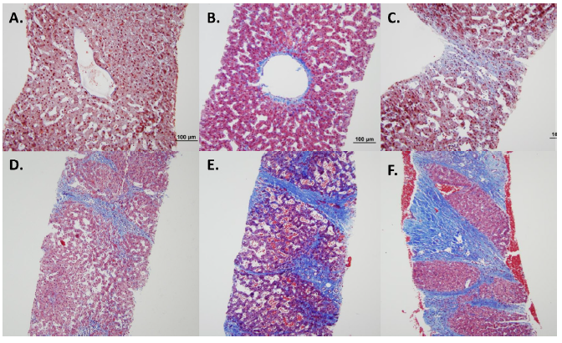
Multi-organ Consequences of Fontan Physiology
Fontan
Fontan Associated Liver Disease (FALD)
Hemodynamic Changes
↑ CVP
Hypoxia
Lymphatics
Sinusoidal stress
↑ Hydrostatic pressure
Peri-sinusoidal edema
Increased matrix stiffness
Tissue Injury
Inflammation
Liver Fibrosis
Cirrhosis
Hepatocellular Carcinoma
Pathology of liver lesions
J Heart Lung Transplant 2014; 33: 170–177
D’Angelo EC, et al. Heart 2022; 108: 1822–1831. doi:10.1136/heartjnl-2022-321006

Slide 13
Pathophysiology of Fontan-Associated Renal Disease
Fontan
↑ CVP
↑ Glomerular filtration pressure
Fontan Circulation
↑ Serum creatinine
↑ Serum cystatin C
↓ eGFR
↓ GFR
↓ Effective Circulation Volume
↓ Renal Perfusion Pressure
Chronic interstitial inflammation and fibrosis
Albuminuria
↑ Urine KIM-1, NAG
Limited ability to augment cardiac output
Glomerular hypertrophy and mesangial proliferation
↑ Renal resistive index
Cardiac surgery associated AKI
Right-to-left shunt Chronic hypoxia
Notes:
↓ ↓

Slide 14
Therapeutic Options for Fontan Failure

Slide 15
Assessment of Etiology(-ies) of Fontan Failure
Therapeutic Options
Fontan Circulatory Failure
Ventricular Failure
TCPC Failure
AVV valve or semilunar valve regurgitation
Assess for coarctation of the aorta, myocardial ischemia
Rule out TCPC or pulmonary stenosis/distortion
Assess for veno-veno collateral, baffle leak
or patent fenestration
Lymphatic pathology and ascites
Adapted from: D’Angelo EC, et al. Heart 2022; 108: 1822–1831. doi:10.1136/heartjnl-2022-321006

Slide 16


Medical Therapies: Limited Data
Therapeutic Options
Pulmonary Vascular Disease
PVR elevated > 2 indexed Wood units
Systolic
Dysfunction
Ejection
fraction <50%
GDMT (little data)
SGLT2i (little data)
Diuretics
Non-pulsatile low shear continuous pulmonary perfusion
Pulmonary Vasodilators
(ESC Class IIb, Level C)
Diastolic Dysfunction
End-diastolic pressure
≥ 12 mmHg
GDMT (little data)
SGLT2i (little data)
Diuretics
Fontan Pathway Thrombosis
Systemic venous hypertension
Decrease in cardiac output
Atrial Arrhythmia
Maintenance of sinus rhythm
Risk factors: History thrombus,
past thromboembolic event,
atrial arrhythmia
Anti-Arrhythmics
Anti-coagulation (AHA, ESC Class 1, Level C)
Atrio-Ventricular Valve Regurgitation
Extra-cardiac
ARB/ACEI/ARNI
Diuretics
Lymphatic dysfunction and Fontan associated liver disease
Adapted from: D’Angelo EC, et al. Heart 2022; 108: 1822–1831. doi:10.1136/heartjnl-2022-321006

Slide 17
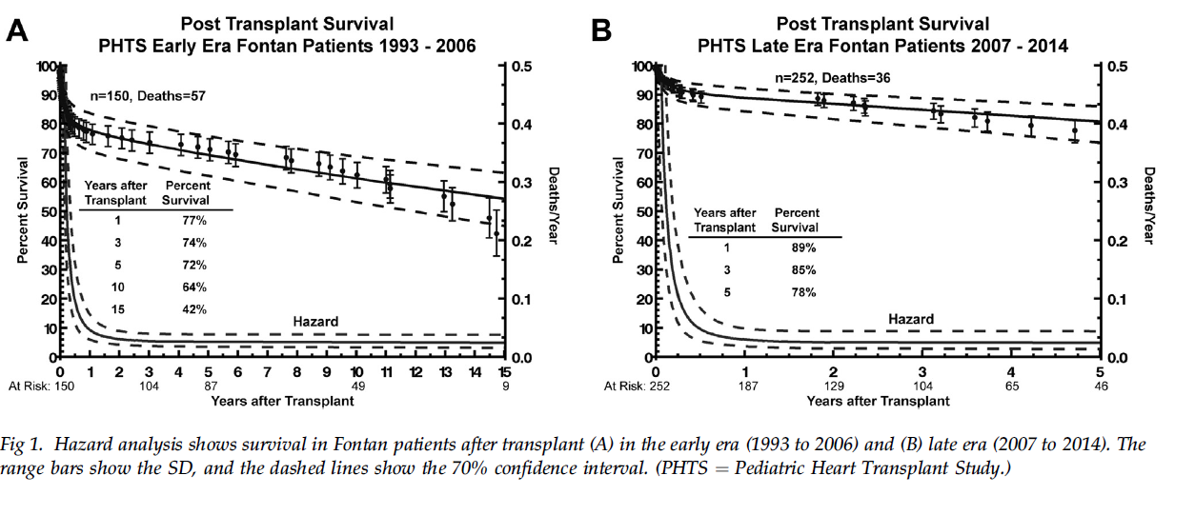
Heart Transplant Outcomes for Children with Fontan Procedure are Improving in the Recent Era
Therapeutic Options
w
Early phase mortality remains most challenging period post-heart transplant.
89% survival at
1 year in most recent era.
Ann Thorac Surg 2017; 103: 1315 21

Slide 18
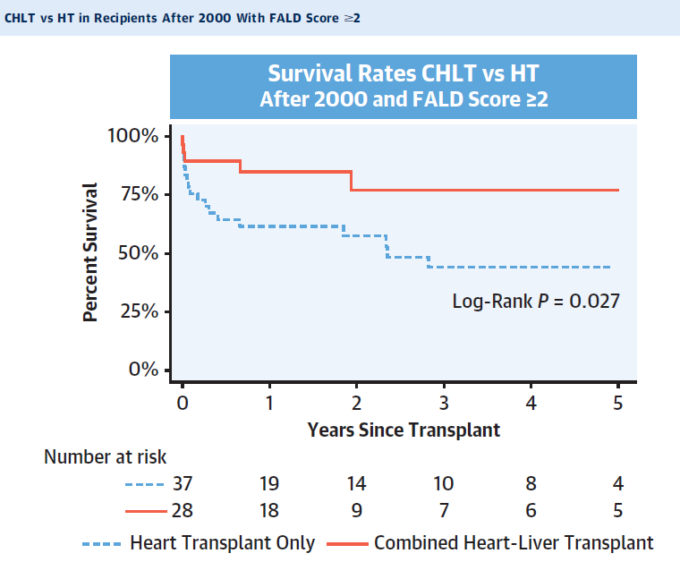
Outcomes of Adult Heart and Combined Heart
and Liver Transplant
Therapeutic Options
Foster Study
For Fontan patients with FALD score >=2 a heart transplant alone resulted in inferior survival than a heart-liver transplant.
JACC Vol. 81, No.22, 2023

Slide 19
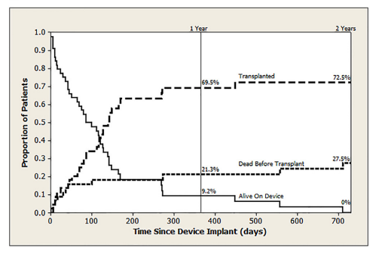
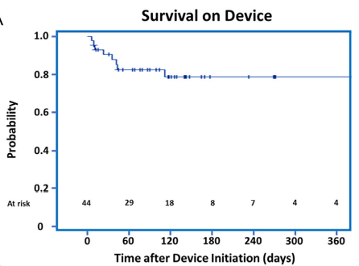
VADs in Fontan Patients: Survival Outcomes
Therapeutic Options
w
80%
alive, transplanted
or on device
at 1 year.
The Journal of Heart and Lung Transplantation, Vol 40, No 5, May 2021

Slide 20
VADs in Fontan Patients: Decrease in PCWP
Therapeutic Options
w
The Journal of Heart and Lung Transplantation, Vol 40, No 5, May 2021

Slide 21
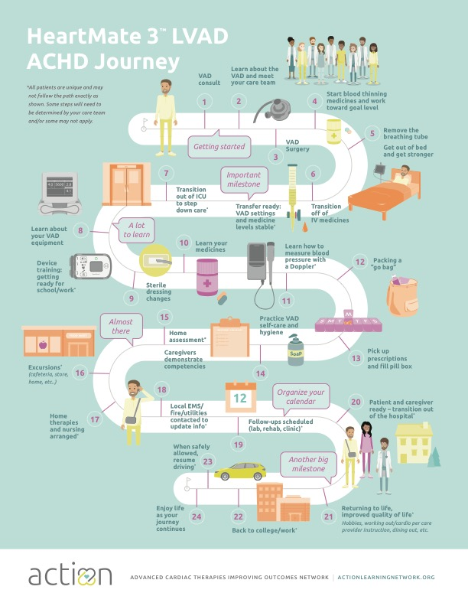
VADs in Fontan Patients: Rehabilitation
Therapeutic Options
Can we resuscitate end organs, reverse frailty and improve quality of life?

Slide 22
Current Summary
Therapeutic Options
Fontan patients are increasingly surviving into adulthood, but with ongoing risk for long-term cardiac and multiorgan sequela.
There is limited data for cardiac medications for Fontan failure.
Fontan patients with failing physiology should be considered for advanced heart failure therapies (VAD, heart transplant).
Increasingly, Fontan patients with advanced heart failure are undergoing successful VAD implantation and heart transplantation.
Both VAD and heart transplant outcomes for Fontan patients continue to improve.

Slide 23
ACTION Steps

Slide 24

THE PROBLEM
Despite the prevalence of patients with Fontan circulation …..
Cardiac devices and medicines are rarely
developed or studied for patients with this physiology.

Slide 25
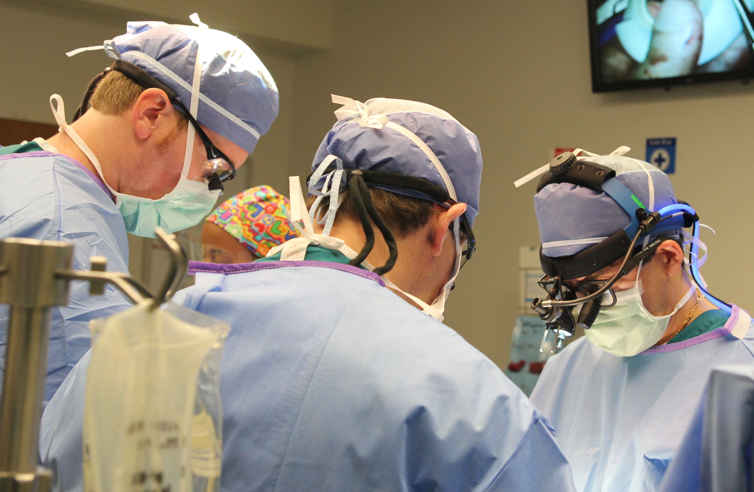
THE PROBLEM
We don’t always have the right treatments...
Most heart failure medicines are used in Fontan patients without data
Difficult to know when to refer for advanced therapies.
Most Fontan patients that need a VAD do not have the right devices available.

Slide 26

THE BARRIERS
The best therapies are not developed for these patients due to…
Relatively small patient numbers
Lack of economic incentive
Burden of data collection
Suboptimal awareness of the problem

Slide 27

Now is the time
for ACTION.

Slide 28
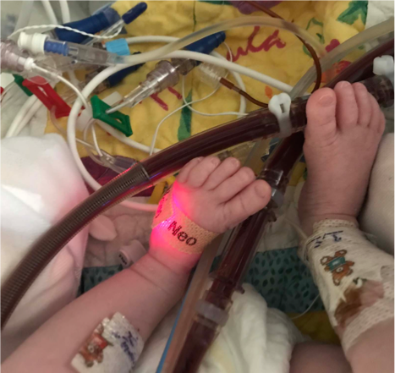







ACTION Steps
Our Solution
A learning health network to bring everyone together
Patients
+
Caregivers
Providers
+
Institutions
Research
+
Technology
Regulatory
+
Industry

Slide 29

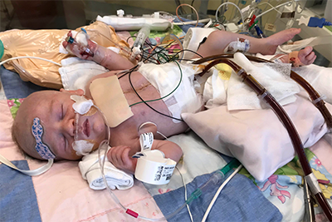






ACTION Steps
Our Patient Populations & Data Registries
  Cardiomyopathy/
  Congenital Heart Disease
  Ventricle Assist Device (VAD)
  Muscular
  Dystrophy
  Pediatric & Adult Fontan Circulatory Failure
Notes:
ACTION will have the most reliable data at a low cost. To ensure that this is true we will:
Audit site data
Adjudicate adverse events
Link to other data sources
Format for use as Real World Data
Collect patient reported data and outcomes
Use data to determine network priorities

Slide 30
ACTION Research

Slide 31
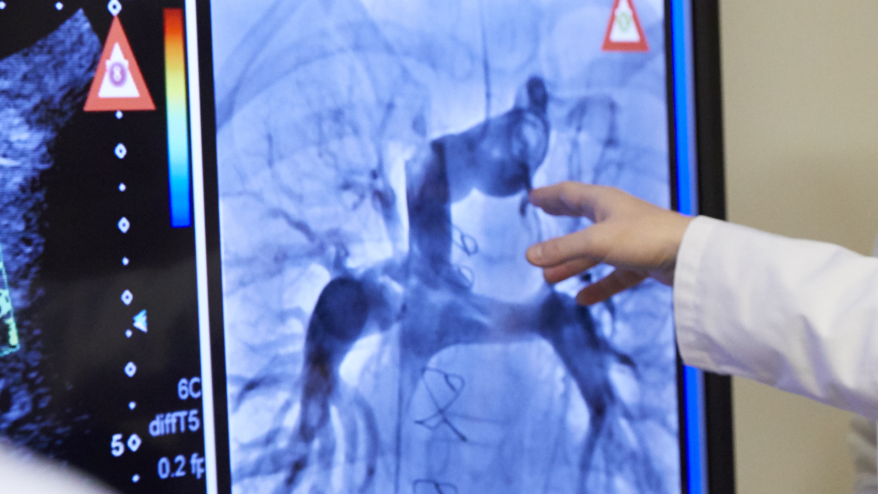
ACTION PUBLICATION
Outcomes After Initial Heart Failure Consultation in Fontan Patients: An ACTION Initiative
CITATION
Chen S, Shezad MF, Lorts A, et al. Outcomes after initial heart failure consultation in Fontan patients. Cardiology in the Young. 2023:1-8. doi:10.1017/S1047951123003852
PMID: 38014551

Slide 32
Study Details
ACTION Publication Research
w
Inclusions & Methods
Outcomes
Fontan patients (any age) at the time of an initial consultation with a heart failure/heart transplant team
Follow-up survey was sent at 30 days to determine outcome after initial consultation.
Late Referral: Defined as death or declined for HT and/or VAD because
too sick.
Care Escalation: Defined as VAD implant, inotrope initiation or Heart Transplant listing.

Slide 33

Key Results
ACTION Publication Research
w
60 patients were collected across 13 sites (7/2019-2/2021) : 50% were inpatient consults and 33% of inpatients were already on inotropic support at time of consult.
Late Referrals 12% (7/60)
Too Sick (6)
Died (1)
30
Inotrope (6)
VAD (4)
HTx List (16)
Care Escalation 38% (26/60)

Slide 34

Risk Factors for Late Referral
ACTION Publication Research
w
Initial consult ≤ 1-year post-Fontan
(OR 8.8, 95% CI 1.6-47.7, p=0.012)
Inpatient at initial consult
(OR 3.1, 95% CI 1.1-8.8, p=0.040)

Slide 35

PUBLICATION
Considerations for Advanced Heart Failure Consultation in Individuals With Fontan Circulation: Recommendations From ACTION
CITATION
Lubert AM, et al. Considerations for Advanced Heart Failure Consultation in Individuals With Fontan Circulation: Recommendations From ACTION. Circulation: Heart Failure. 2023 Feb;16(2). DOI: 10.1161/CIRCHEARTFAILURE.122.010123

Slide 36
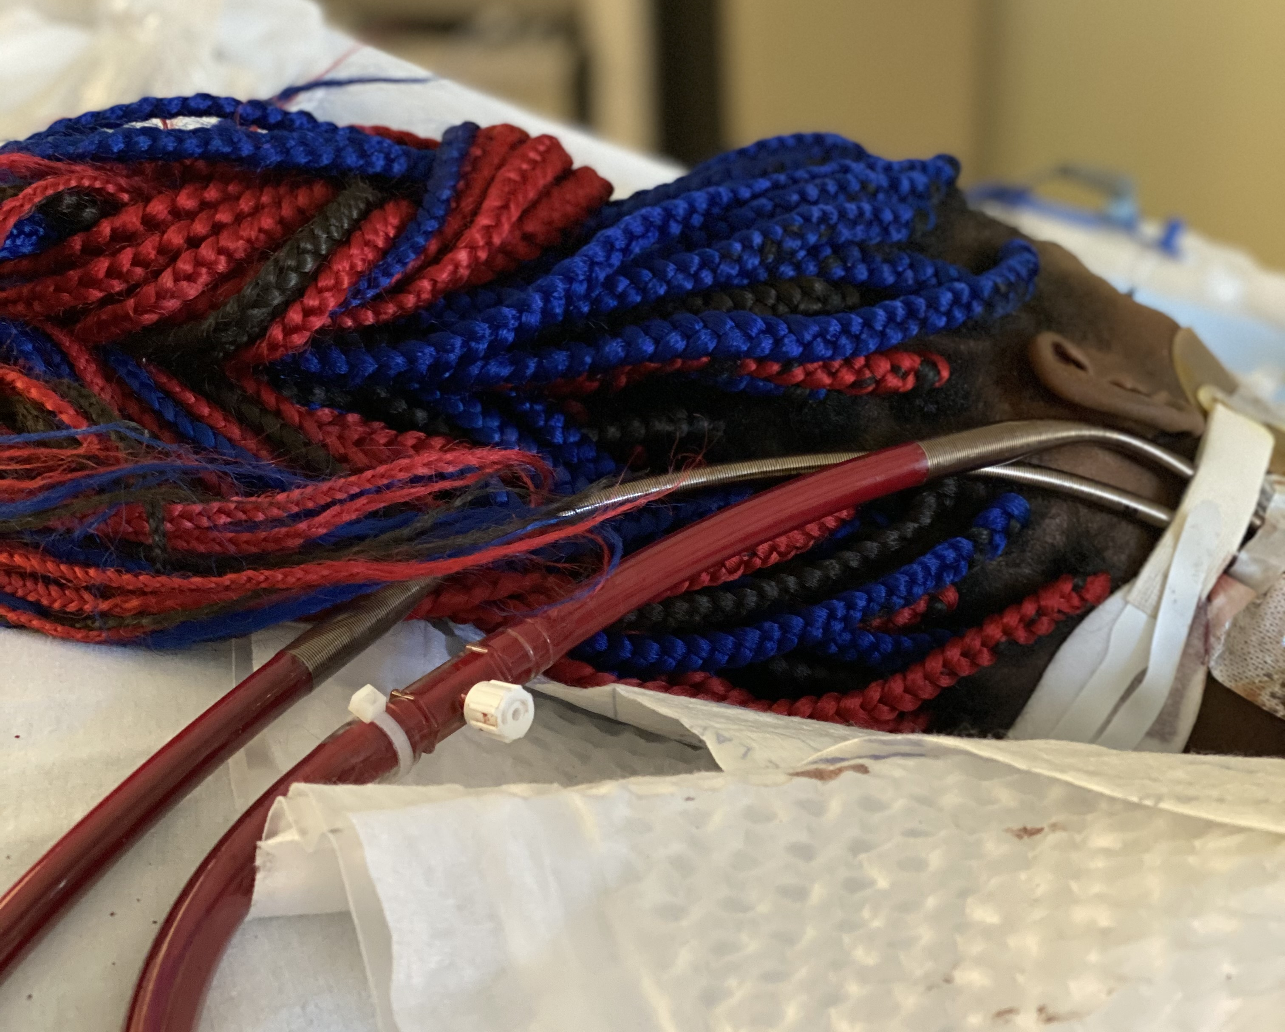
Why Refer to Advanced Heart Failure Team?
ACTION Publication Research
w
Co-manage and collaborate
Get to know patient and family
New HF drugs
Quickly changing device options
Gain expertise in patient selection and
evaluation for advanced therapies
Early transplant options are better

Slide 37
“
“
“
We do not want to meet a new team when health is declining rapidly. Would prefer to meet them early and build relationship with both teams together.
“
“
“
. . . . . . .
MOTHER
Fontan Patient

Slide 38
When to Consider Advanced Heart Failure Therapies
ACTION Publication Research
w
Fontan Pathway Dysfunction
Cardiac/Systemic Ventricular Dysfunction
Symptomatic, chronic fluid overload
Chronic/refractory effusions or ascites
Symptomatic hemodynamic disturbances/cyanosis
Severe ventricular dysfunction or dilation
Moderate dysfunction with moderate AVVR
Growth failure
Decreased exercise tolerance
Recurrent arrhythmias
Extra-cardiac Dysfunction
Lymphatic Dysfunction
Need for liver transplant
Synthetic liver dysfunction
Hepatocellular carcinoma
CKD stage 3
Recurrent hemoptysis
Refractory PLE
Plastic bronchitis requiring chronic therapy
Advanced Heart Failure Consultation

Slide 39
Cardiac/Systemic Ventricular Dysfunction
ACTION Publication Research
w
Severe systolic dysfunction (EF <35% for systemic left ventricles and <30% for right ventricles) by echocardiogram or MRI or severe ventricular dilation (indexed end-diastolic volume >156 mL/BSA)by cardiac MRI.
Moderately depressed systolic function (by qualitative assessment, echo or MRI) when accompanied by moderate or greater systemic atrioventricular valve regurgitation.
Significant growth derangements including cachexia and linear growth failure.
Decreasing exercise tolerance by patient report or as measured on sequential formal exercise testing or 6-min walk tests.
Significant electrophysiologic abnormalities, including recurrent arrhythmias despite therapy, implantation of a cardiac pacemaker, or aborted sudden cardiac death event.

Slide 40
Fontan Pathway Dysfunction
ACTION Publication Research
w
Symptomatic, chronic fluid overload persisting despite new or increasing diuretic therapy.
Example: The need for multiple increases in diuretics (either dose or frequency) over a 6-mo period
with continued fluid overload.
Occurrence of chronic pleural effusions or ascites, chylous, or nonchylous, refractory to therapy and occurring outside the initial Fontan postoperative period.
Major hemodynamic disturbance resulting in symptoms despite therapy including:
- Low systemic cardiac index (<2 L/min per m2)
- Diastolic dysfunction (ventricular EDP >15)
- Elevated Fontan pressure (Fontan pressure ≥20 mm Hg.
- Symptomatic cyanosis

Slide 41
Lymphatic Dysfunction
ACTION Publication Research
w
PLE that has failed medical therapy
Example: Need for >1 PLE-related hospital admission in a 12-mo period, PLE requiring
repeated albumin infusions to treat symptoms despite standard PLE medical therapy,
or PLE with steroid side effects from ongoing budesonide therapy.
Plastic bronchitis requiring chronic therapy or inpatient hospital admission.

Slide 42
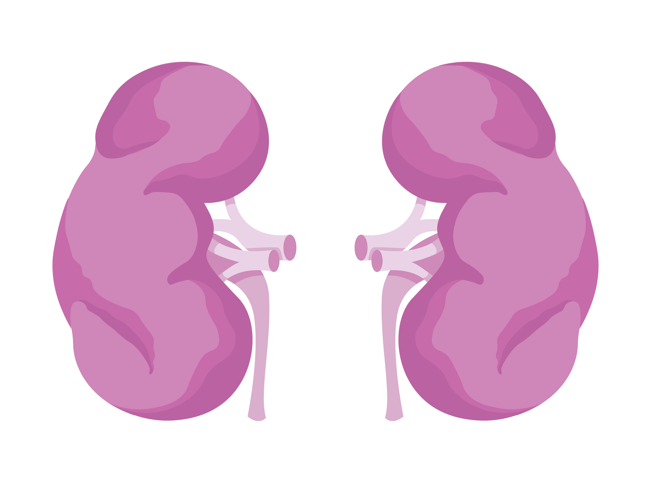
Extracardiac Dysfunction
ACTION Publication Research
w
Liver disease with impaired synthetic function/abnormal liver function testing or undergoing evaluation for liver transplantation or hepatocellular carcinoma.
Chronic kidney disease–stage 3 or greater.
Hemoptysis requiring evaluation that is unrelated to an infection and persists after standard intervention.

Slide 43
Study Summary
ACTION Publication Research
w
Continued collaboration between the families, primary Fontan Cardiologist and Heart failure/Transplant cardiologist is key to ensuring improved outcomes.

Slide 44
Referrals

Slide 45

Referrals
How to Refer
…a Fontan patient for advanced heart failure therapies at our institution:
All sites to enter site specific information as to how these can be done.
Consider dividing “how to consult” for outpatient and inpatient separately.
For sites that have a Fontan multidisciplinary clinic, may be easier for the heart failure/transplant cardiologist to come and discuss with families there to avoid an extra visit

Slide 46

Audience Members
Scan the QR code to take the brief post-presentation survey

Slide 47

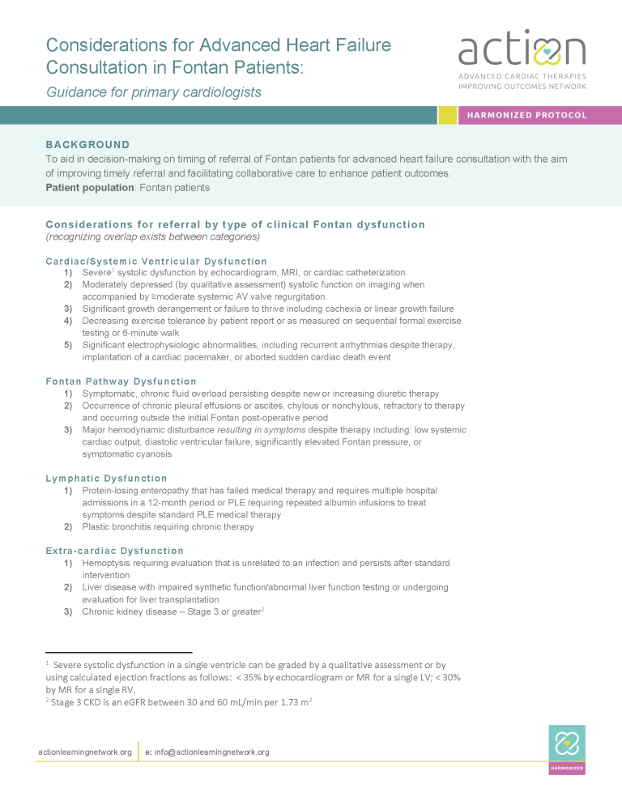
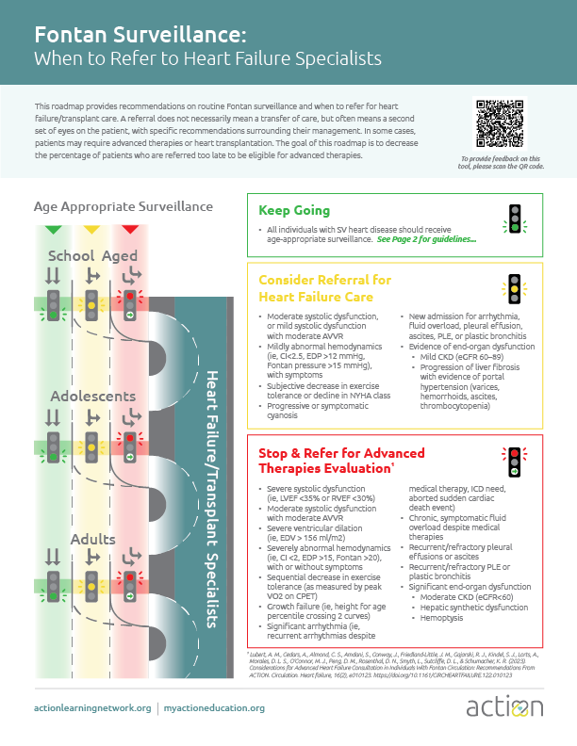


Thank you.
Looking for additional
Fontan referral resources?
Scan the QR code or visit
actionlearningnetwork.org/
action-projects/fontan-referral
Consideration for Advanced
Heart Failure Consultation
in Fontan Patients
Fontan Surveillance:
When to Refer to Heart Failure Specialists
actionlearningnetwork.org | myactioneducation.org
Action-Learning-Network @Action4HF

Slide 48

Presenters
Scan the QR code to take the brief post-presentation survey

